Slide 1
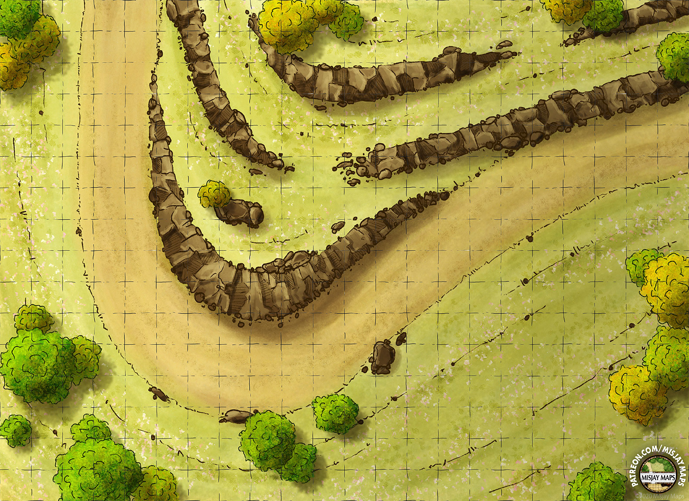
The Hook: There's a go-gang race in 2 days around Seattle, and the Desolation Angels want the other gangs to know they're in Seattle and mean business. The Job: Set a trap and take out whomever is winning the race by the end of the third leg. The Pay: 1000¥ base, plus a bonus for salvaging the lead vehicle in good condition.
Scene 1 (Social). Setting: Underworld 93, a music venue in Puyallup. The Hook: Runners were told by their fixers to meet here for a job. Given dossiers with images, major skills, names of the rest of the team (have players introduce their characters). Events: Influence + CHA (3) – Bartender directs the player to a back room where Mr. Johnson awaits. Influence + CHA (7) – players get the name of the client. Negotiation: per SMG p16, vs Influence 5 CHA 4, 5% increase/decrease in base pay per hit (max still 3k per SMG).
Scene 2 (Investigation). Setting: per players. Available Info:
The race goes around Seattle (map). Begins and ends in Puyallup. Leg 1: Up to I-5. Leg 2: I-5 from Tacoma to Everett. Leg 3: Backroads from Snohomish through to Auburn. Leg 4: Back onto 162.
The biggest entries are 405 Hellhounds, Leather Devils, and Blood Mountain Boys. Most racers will be early career gangers.
Police don't like this race. Leg 2 is heavily monitored (Security Rating A during the race, CRB 239).
The start and finish (Legs 1 and 4) are where the onlookers gather. While some foul play between racers is expected and encouraged, a third party dusting the lead car is not.
Other runners were hired. They’d act during Leg 3 too.
Optional Rules for Initiative. Purpose: Get all players involved in all scenes at First Taste. Social: Influence + CHA. # hits determines order. Ties: Edge, CHA, INT, Coin Flip. Investigation: Perception + INT. # hits determines order. Ties: Edge, INT, REA, Coin Flip.
Scene 3 (Investigation). Setting: The Highway ambush. Edge: 1 per 2 successes in Scene 2 for each player (max 2). Challenges:
The players can set their trap with relevant engineering, stealth, etc. checks.
Perception + INT (3): Players can detect another group setting up a trap. (Failure: players are detected first).
Scene 4 (Combat). Setting: The highway ambush. Edge: 1 per 2 successes in Scene 3 for each player (max 2). Challenges: 1 enemy per player (max 4). Choose from:
Go-Ganger (CRB 204)
Data Harvester (CRB 205, max 1)
Shaman (CRB 204)
Optional Escalations:
The racers begin rounding the bend. Players must set off their trap while engaging the enemy.
Racers enter combat.
First trap fails, leading to vehicle combat.
Shock and Haul
A Shadowrun 6e First Taste by Zeshan Rajput
https://creativecommons.org/licenses/by-sa/3.0/
CRB: Shadowrun 6th Edition Core Rule Book
SMG: Shadowrun Missions Guide v1.6
Map Credit: u/MisjayMaps1 on r/Roll20
Picking Up the Pieces. Pay: negotiated base pay +
500¥ per successful check in laying a trap (scene 3)
1000¥ if other runners can’t complete their mission
Max 3k per player
Karma: 3 karma for adventure survival.
Contacts: Seraphina (Street – Gangs, Connections 3 Loyalty 1) for exceptional mission success. Seraphina is the Desolation Angel who gets the salvaged vehicle and is grateful.

